Slide 1
Entrepreneurial Pathways in the NRV
From Student to Start-up
David Owen Payne
Co-founder, MoGo Mobile

Slide 2
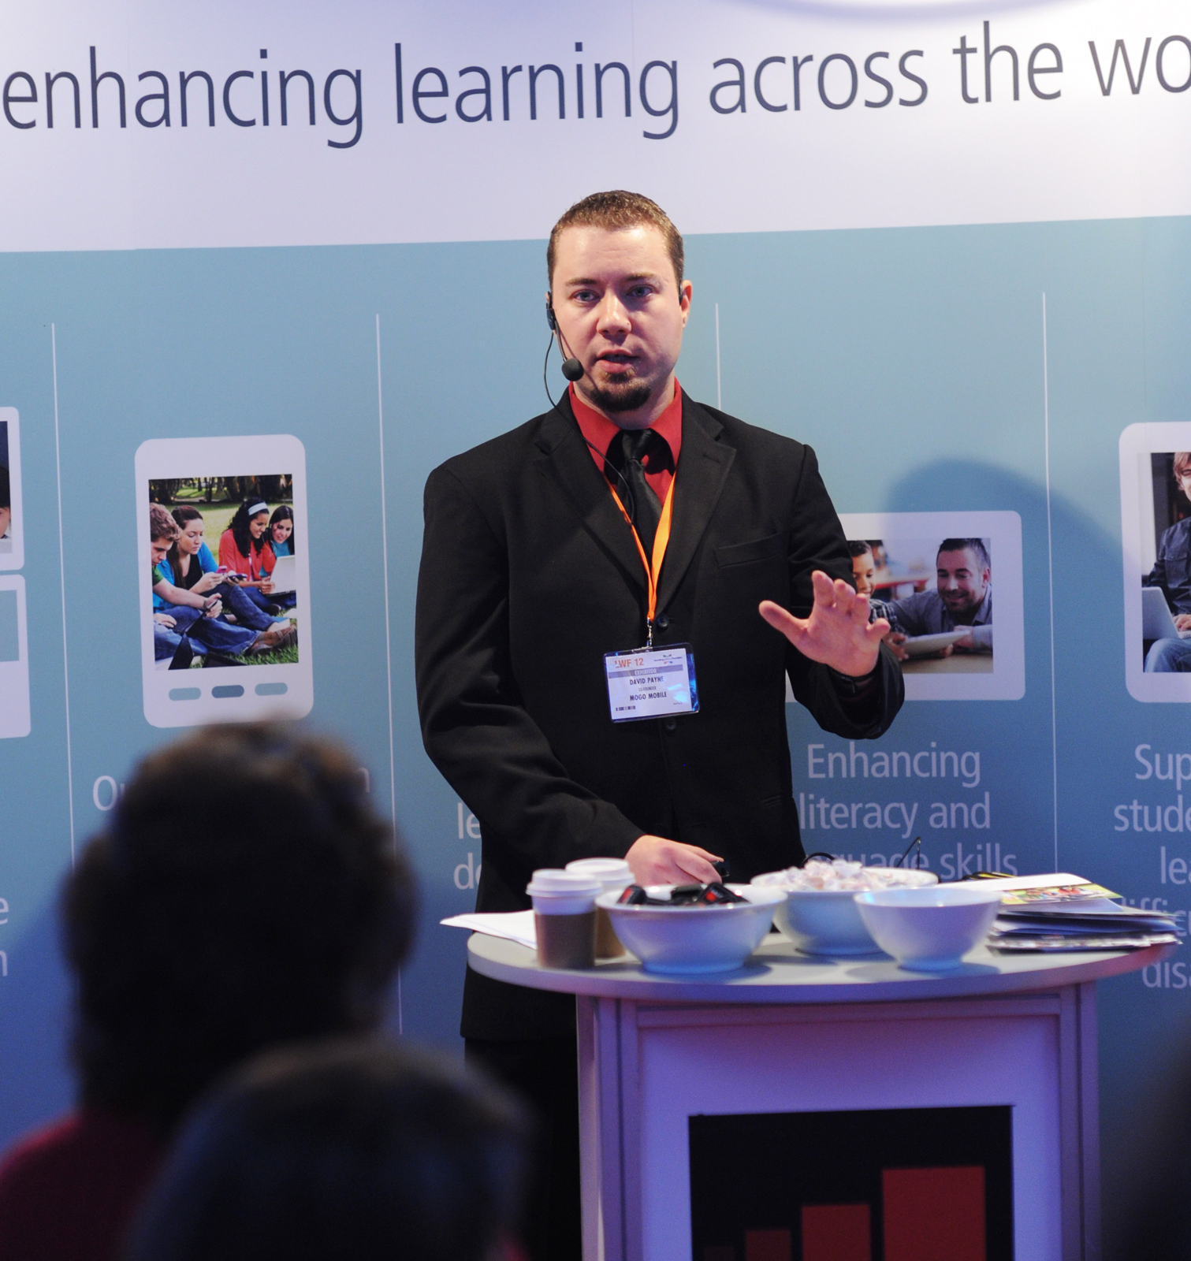
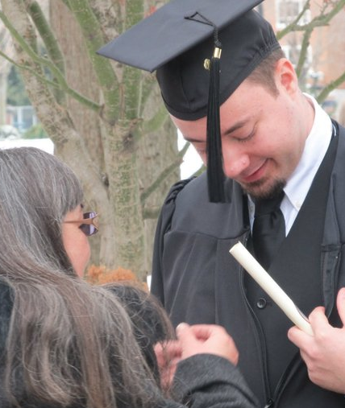
About Me

Slide 3
The New River Valley

Slide 4
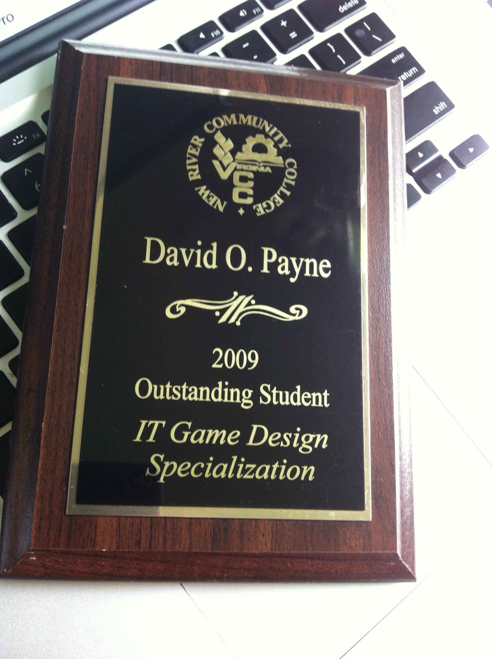
New River Community College

Slide 5
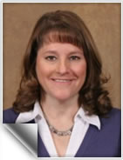
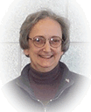
Opportunities from NRCC

Slide 6
Viable Transfer Programs

Slide 7
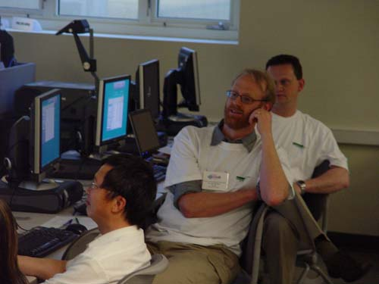
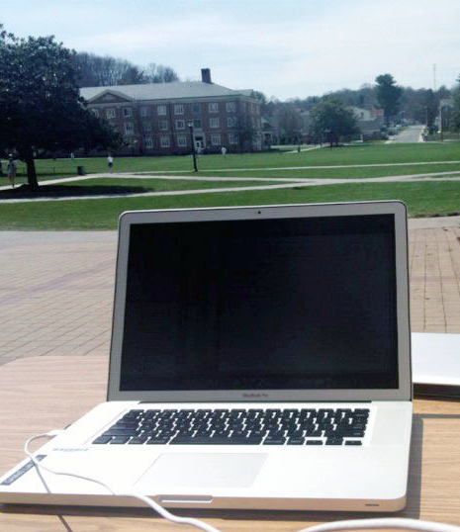
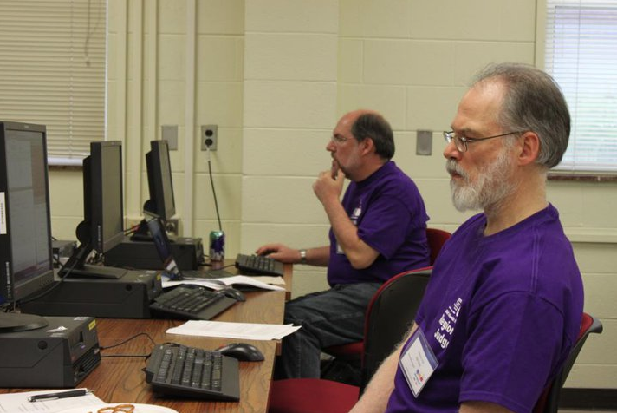
Radford University

Slide 8
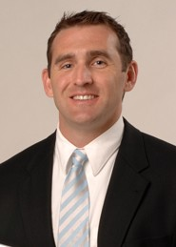
GAMeS Lab

Slide 9
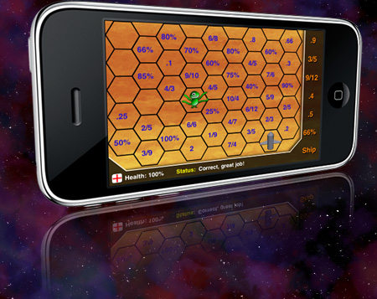
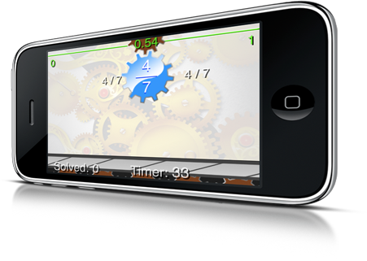
GAMeS Lab @ RU

Slide 10
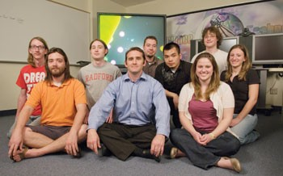
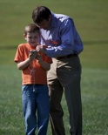
Working With the Right People

Slide 11
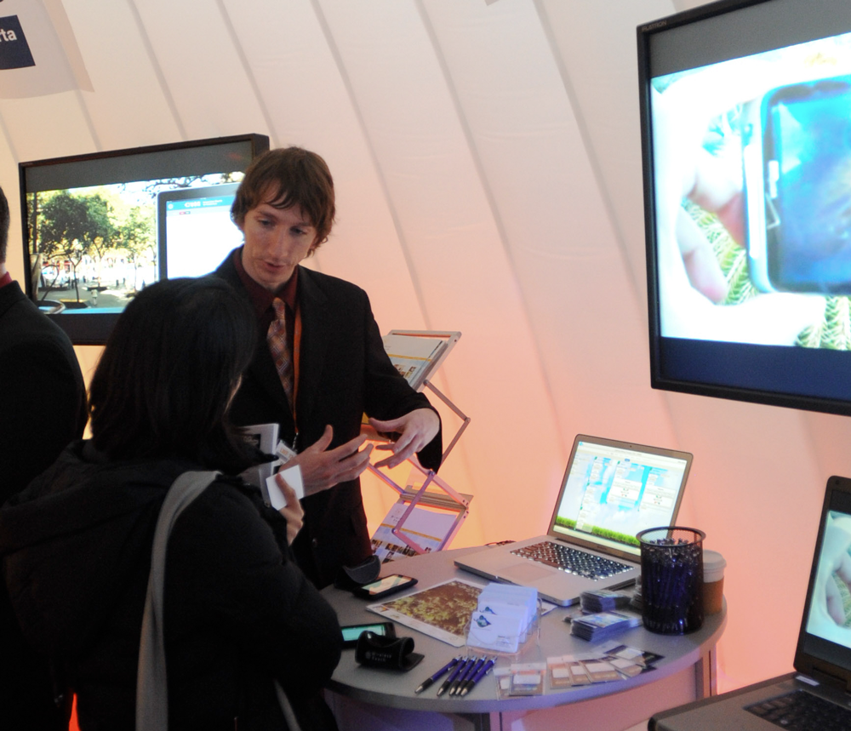
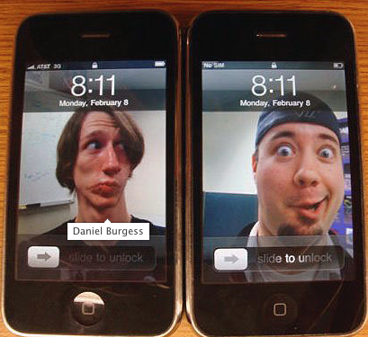
Working With the Right People

Slide 12
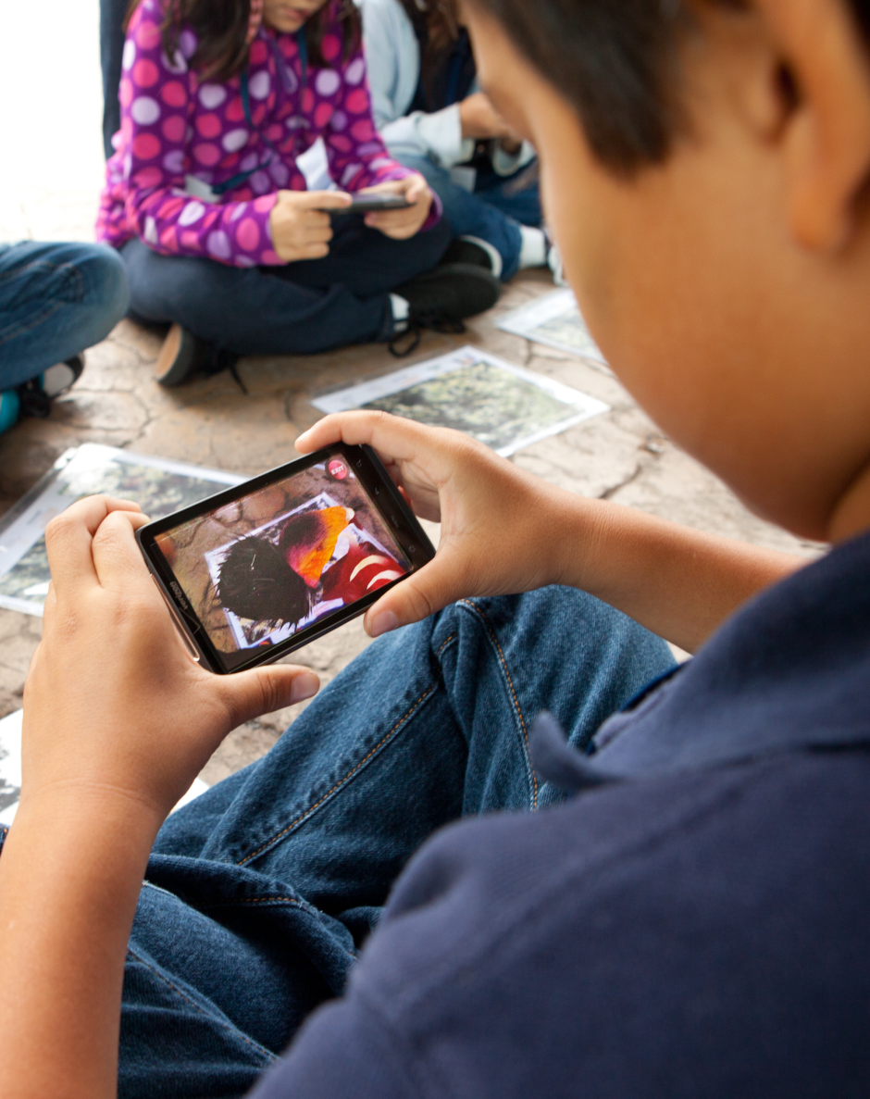
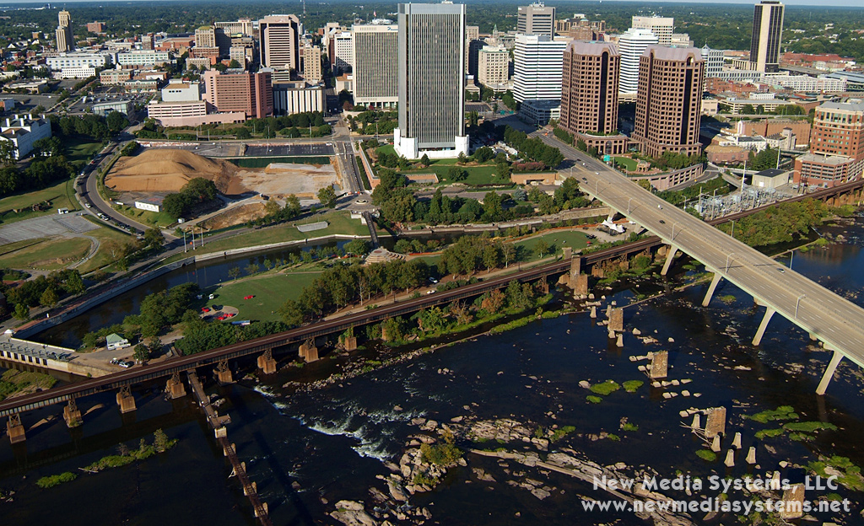
Augmented Reality

Slide 13
MoGo Rising

Slide 14
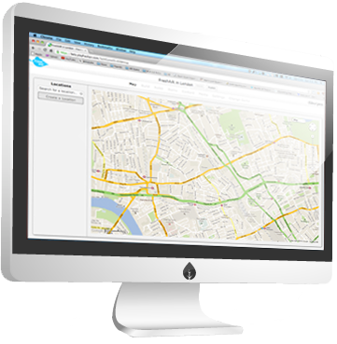
FreshAiR
Online Editor
Smartphone App

Slide 15
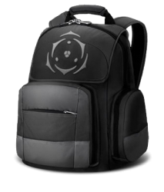
FreshAiR
Add Almost Anything!
Advanced Features

Slide 16
The New River Valley

Slide 17
Key Ingredients for Success
Be Self-Motivated
Seek out Great Institutions & Programs
Make Use of Transfer Programs
Be Part of Grant-Driven R&D Projects
Work With the Right People
Be Very Lucky!

Slide 18
More Information
www.playfreshair.com
David Owen Payne
dave@playfreshair.com
gameslab.radford.edu

